Slide 1


How To Work Alongside AI

Slide 2



Slide 3
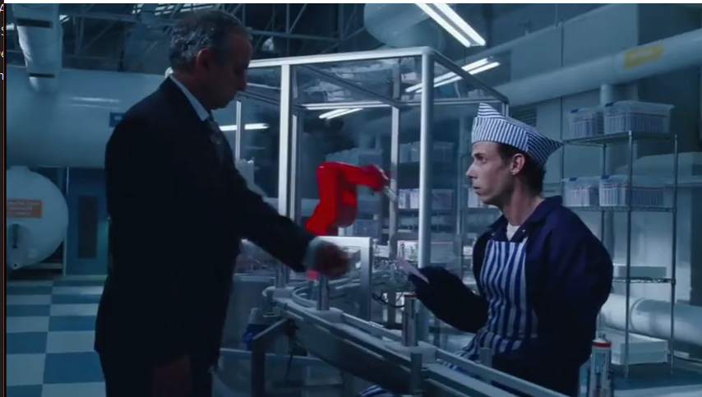
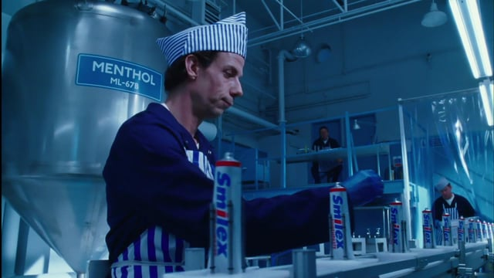
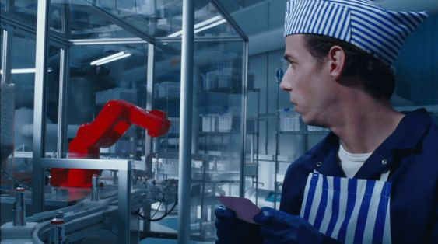

Slide 4

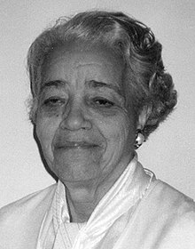

Slide 5
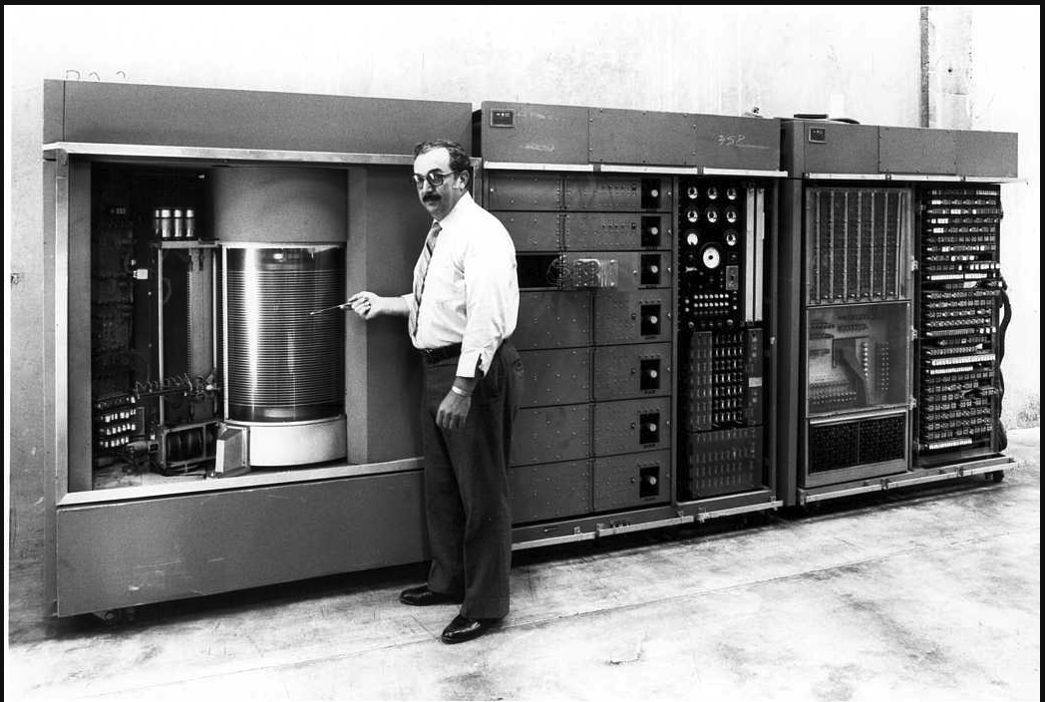
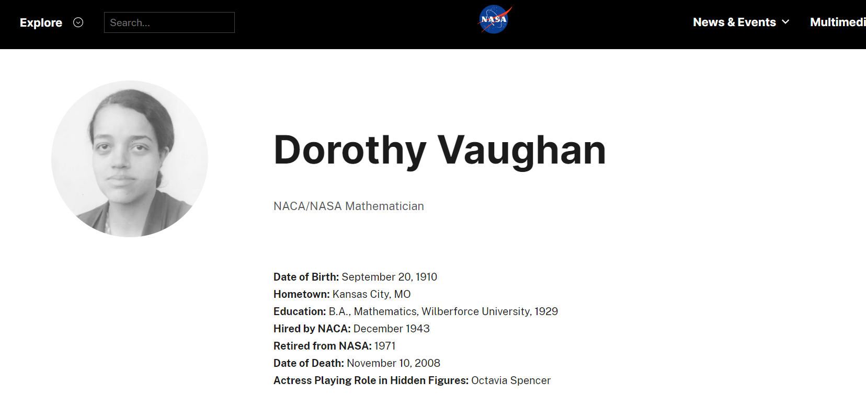

Slide 6
Table of contents
01
02
03
04
05
We need superpowers
What is ai
Is it evil
What can you do
Should you be scared

Slide 7
We need superpowers
01

Slide 8

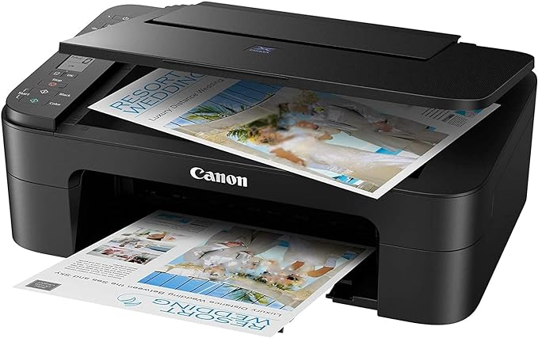
Manuscript

Slide 9
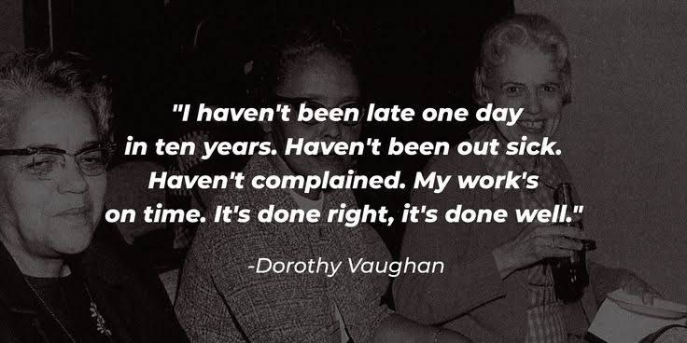

Slide 10
02
What is AI

Slide 11
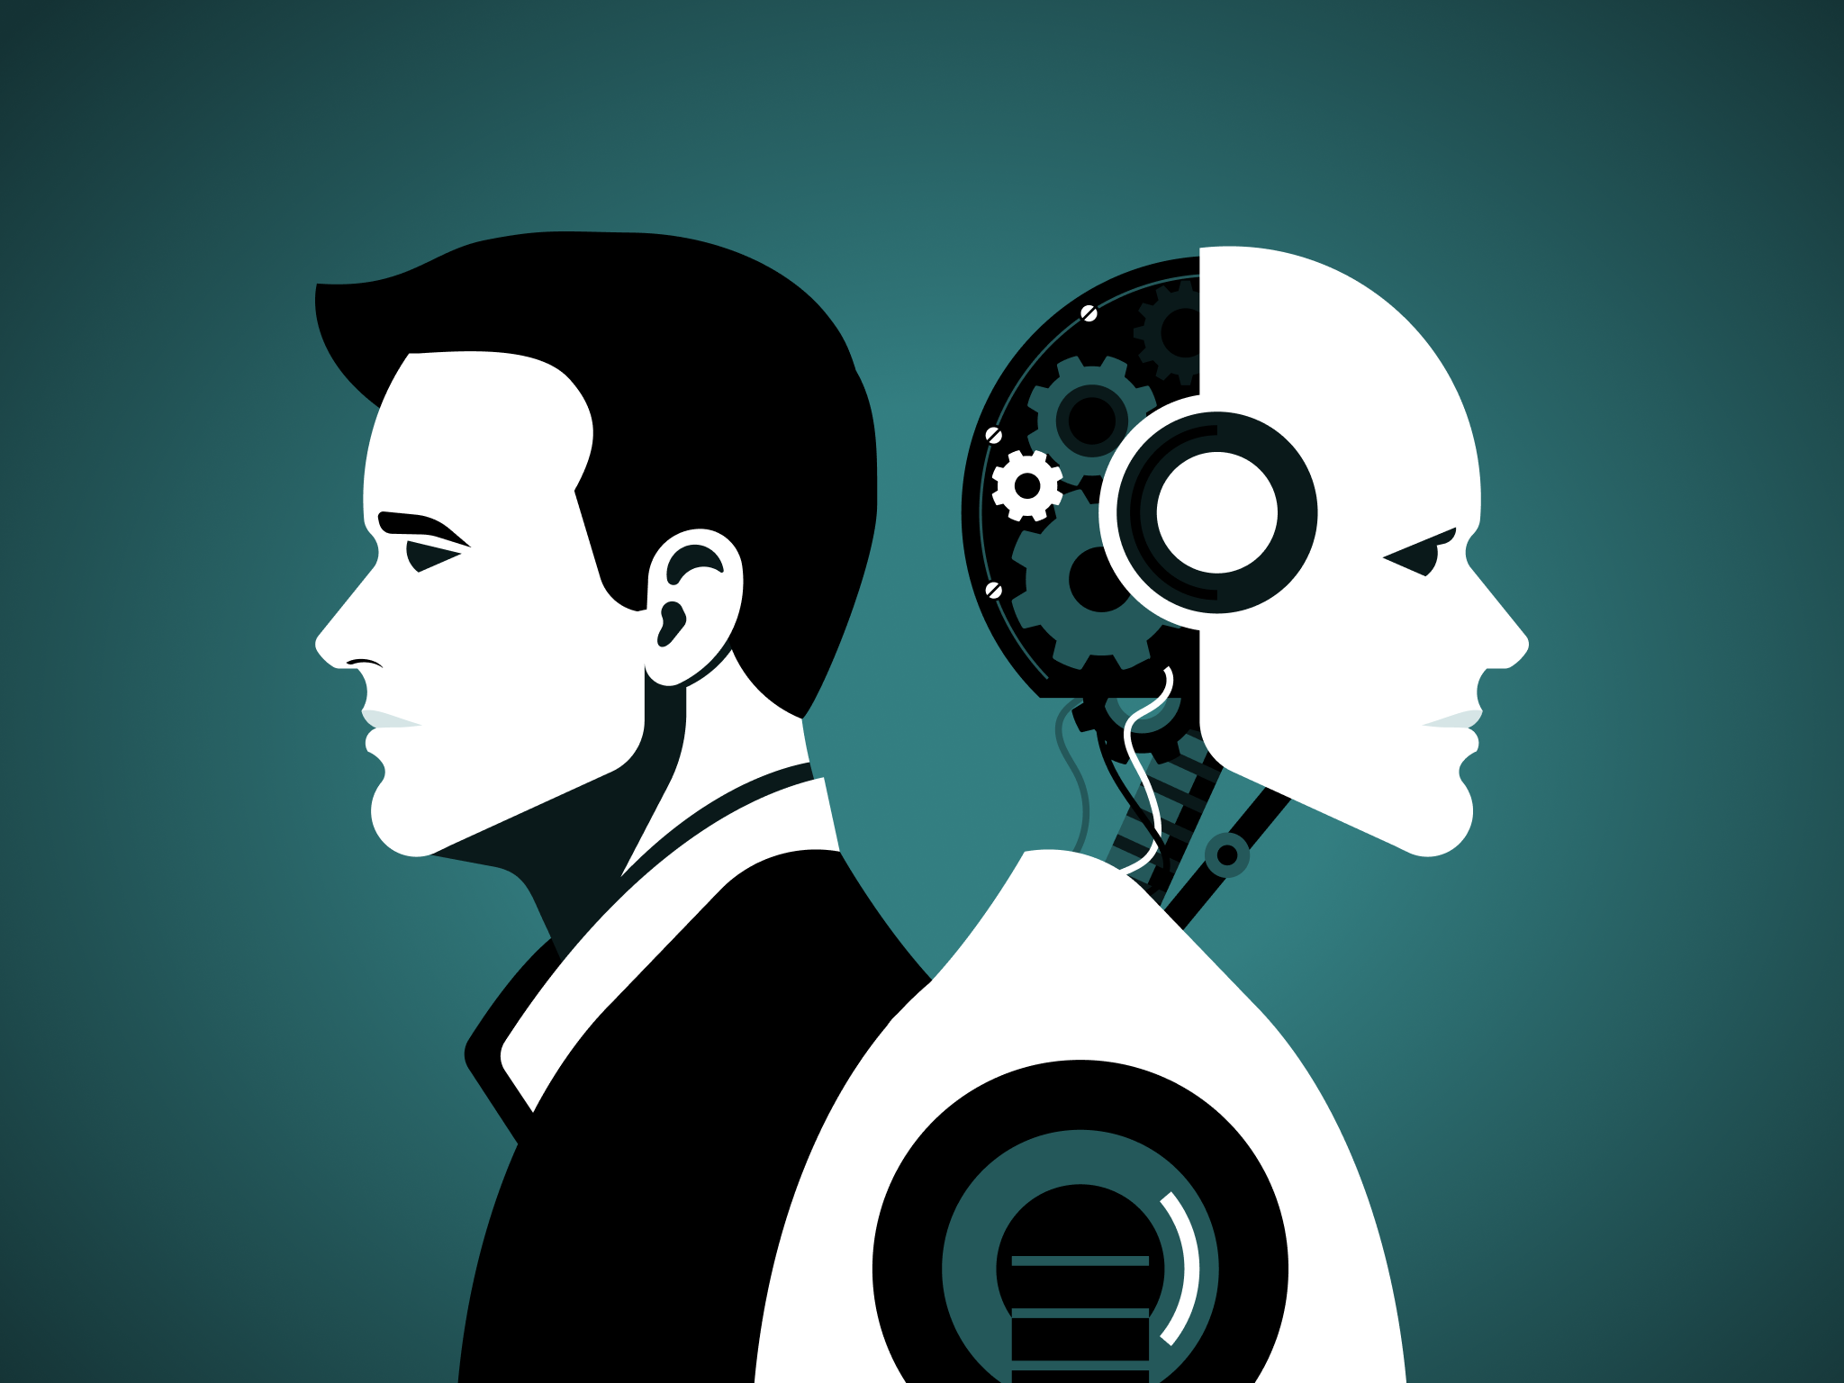

Slide 12
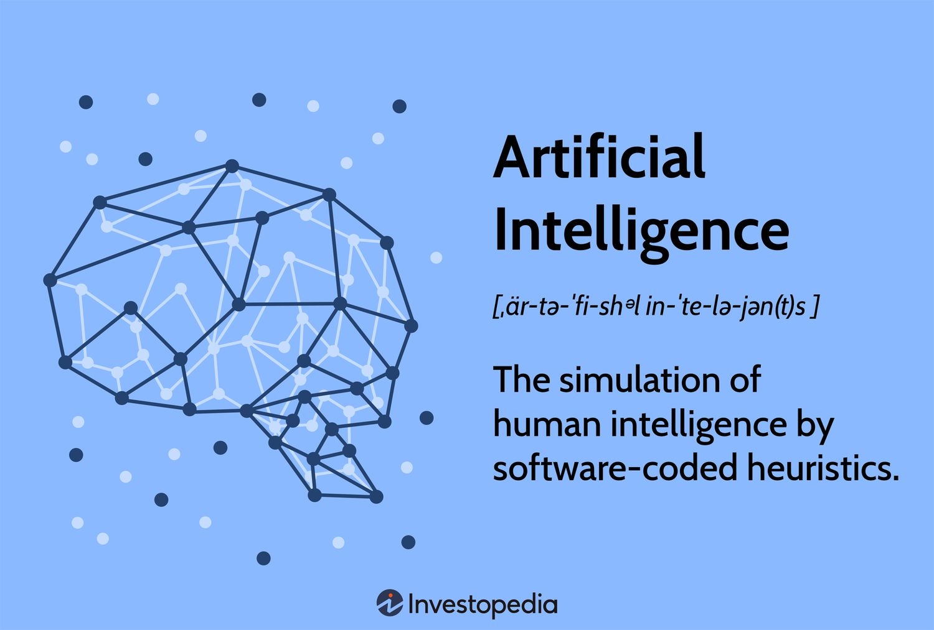

Slide 13
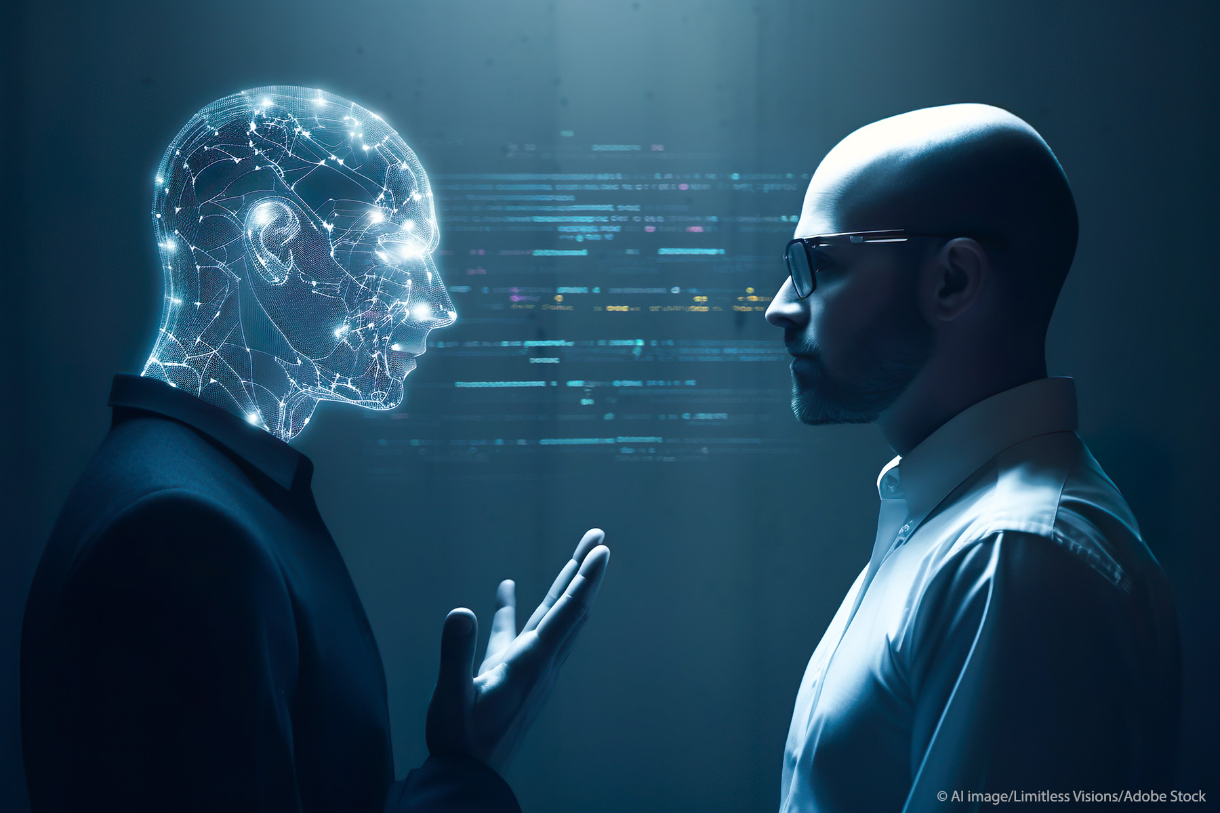

Slide 14
Is it evil
03

Slide 15
Technology is evil
Printer is evil
Machines are evil

Slide 16
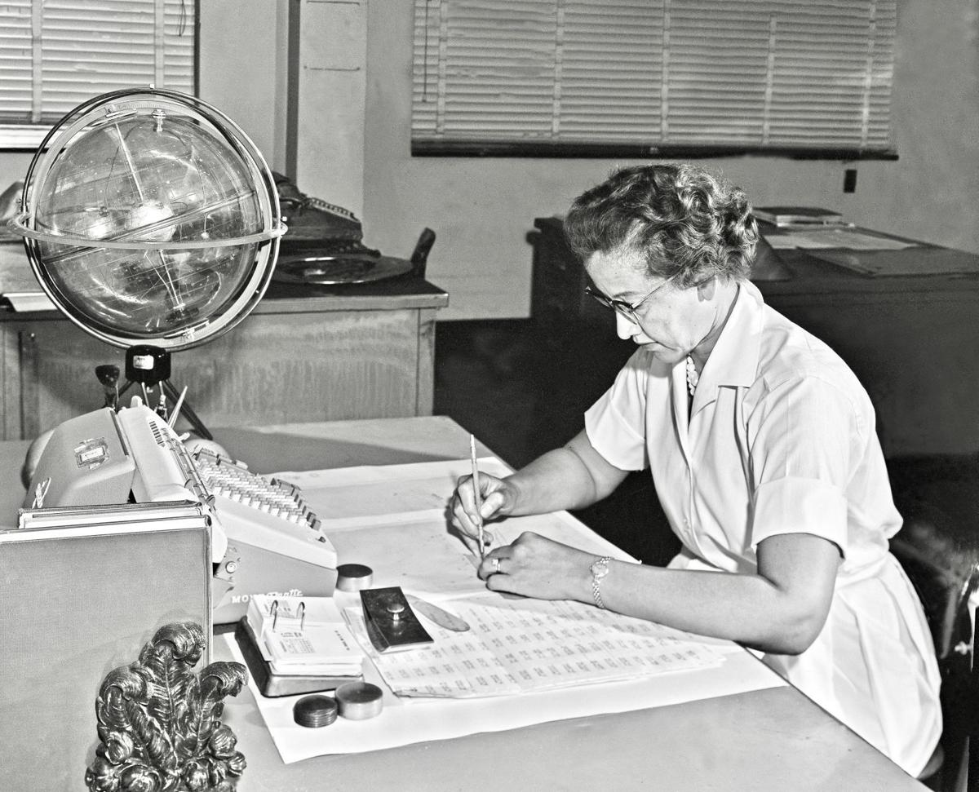
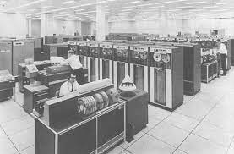

Slide 17


Slide 18
04
What can you do

Slide 19
04
What should you do

Slide 20
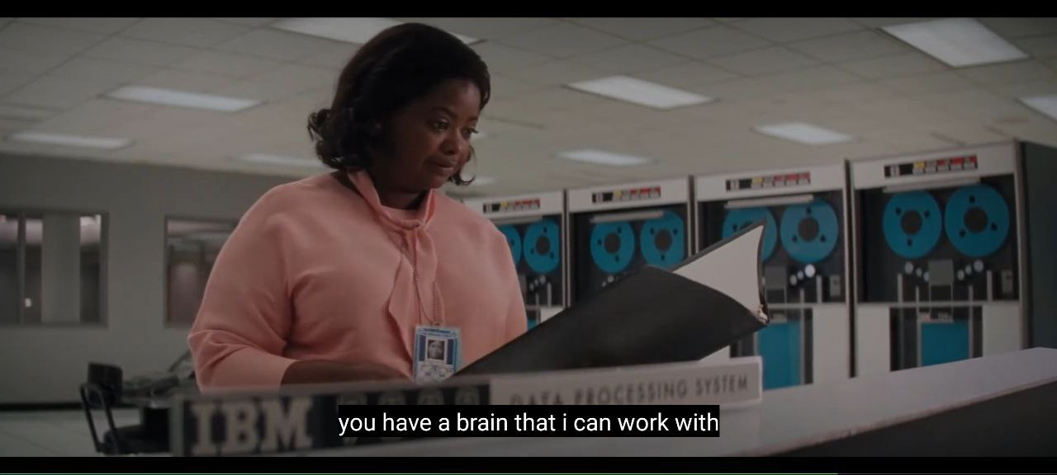

Slide 21
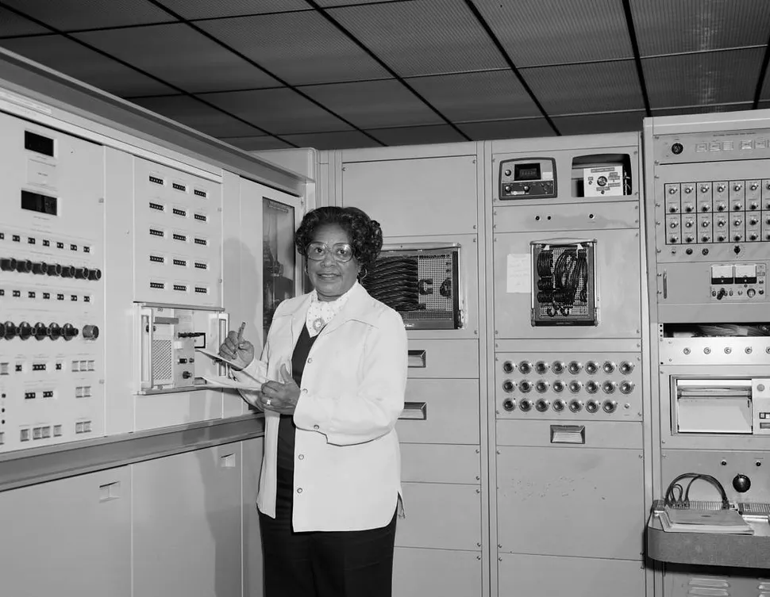

Slide 22
1. Reskilling And Upskilling
2. Promoting A Lifelong Learning Culture
3. Accept that AI is superhuman—but you’re not

Slide 23
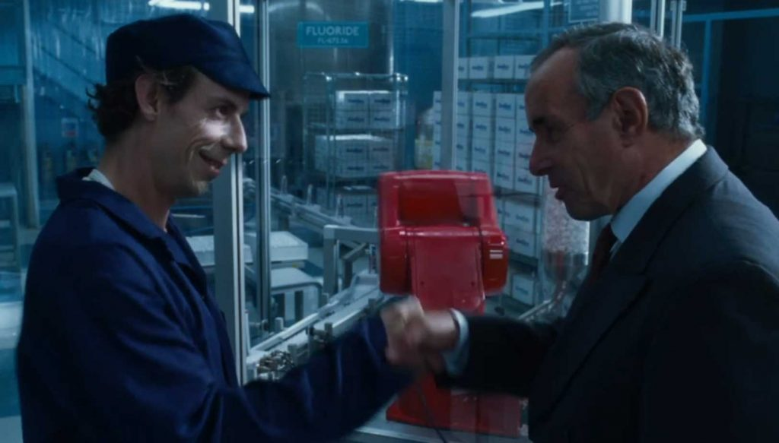

Slide 24
Should you be scared
05
, developer

Slide 25
References
Hidden Figures
Charlie and the chocolate factory
eLearning industry
Korn ferry advance

